Slide 1

Report of the CGU
‘Impact of the Covid-19 on University Education’
By the Compostela Group of Universities
March-September 2020

Slide 2

‘Impact of the Covid-19 on University Education’
New decade vs Covid-19:
Different social situation
Updated Education systems needed
Uncertainty on air
Identification of new indicators required
Utility of the network

Slide 3

Objectives
To know the impact of the pandemic on member Universities
To find out how the Education system is being affected
To learn from the experience
To face the future
Report of the CGU: ‘Impact of the Covid-19 on University Education’

Slide 4
Methodology
Beneficiaries
University community
Target group
Member Universities
Scope
CGU area of influence
(society)
(Asia, and America & EU mainly)
(bodies & CGU delegates)
Report of the CGU: ‘Impact of the Covid-19 on University Education’

Slide 5
Methodology
Questions
54 questions
Structure
4 thematic groups
Perspective
Internationalization, mobility, vulnerable students, telework
(25 open, 10 close-ended & 19 mixed)
(economy, education & research, management and conclusions)
Report of the CGU: ‘Impact of the Covid-19 on University Education’

Slide 6
Preliminary data
Answers
31 answers from 64 member Universities
Origin
18 Anonymous & 13 manifest origin (EU & America)
Report of the CGU: ‘Impact of the Covid-19 on University Education’

Slide 7
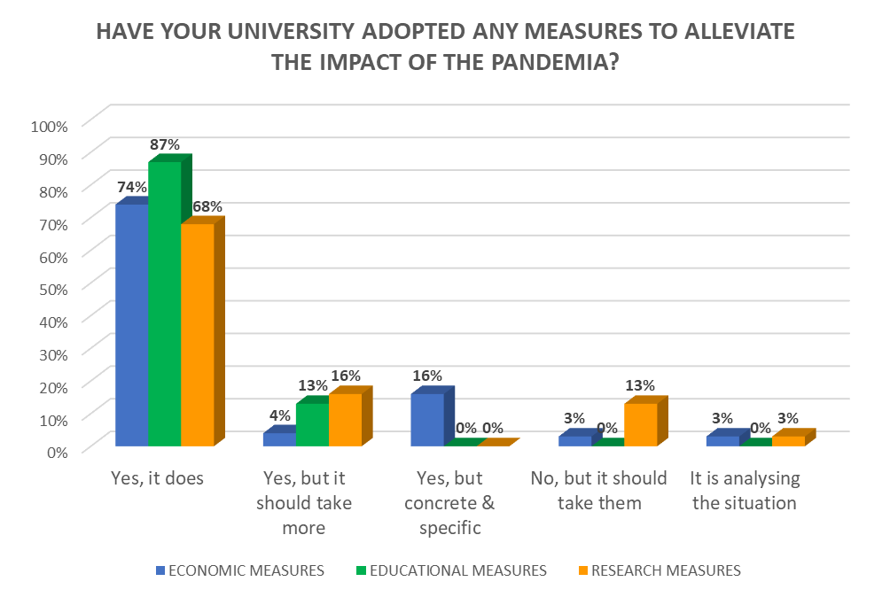
Preliminary data
Report of the CGU: ‘Impact of the Covid-19 on University Education’

Slide 8
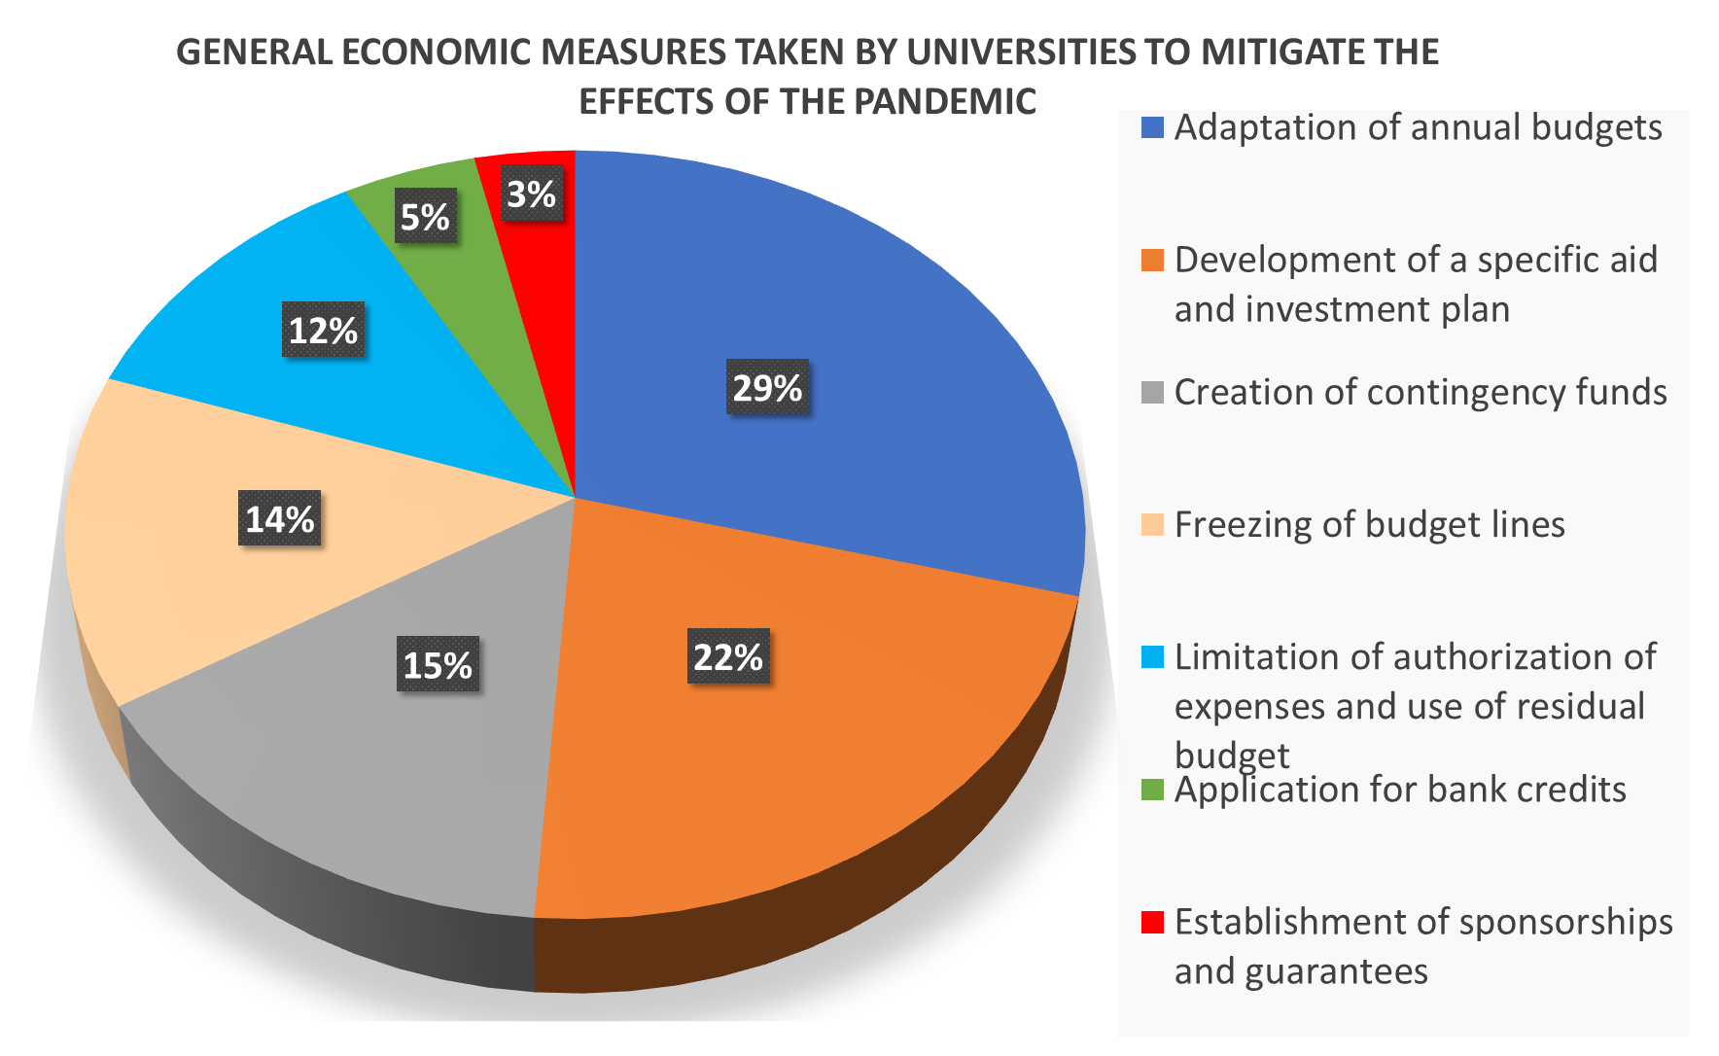
Economic aspects
Report of the CGU: ‘Impact of the Covid-19 on University Education’

Slide 9
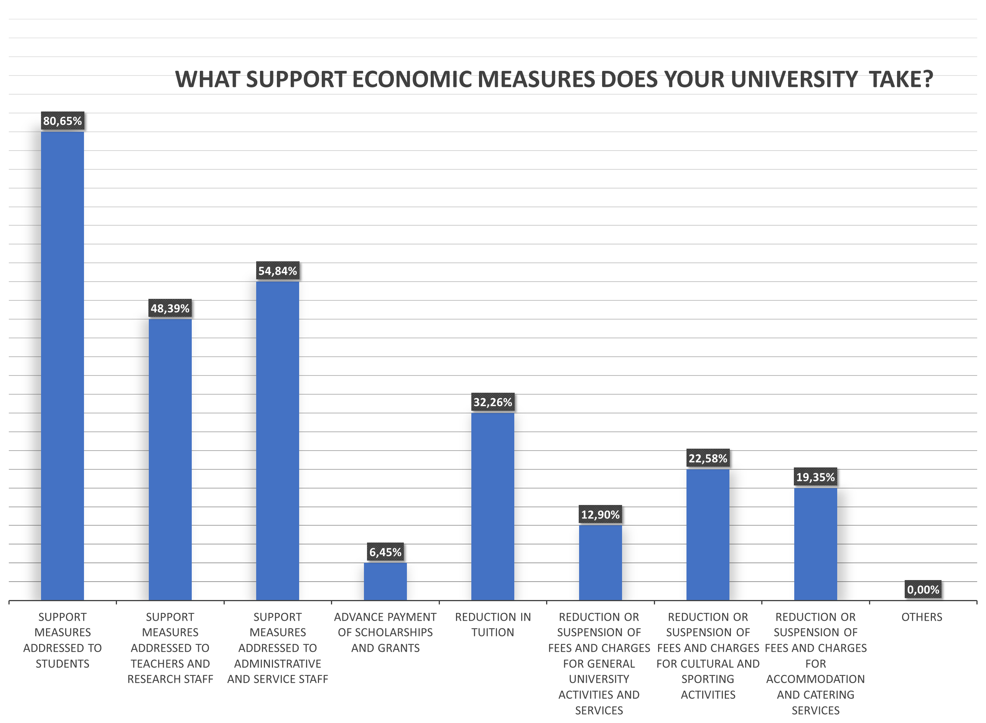
Economic aspects
Report of the CGU: ‘Impact of the Covid-19 on University Education’

Slide 10
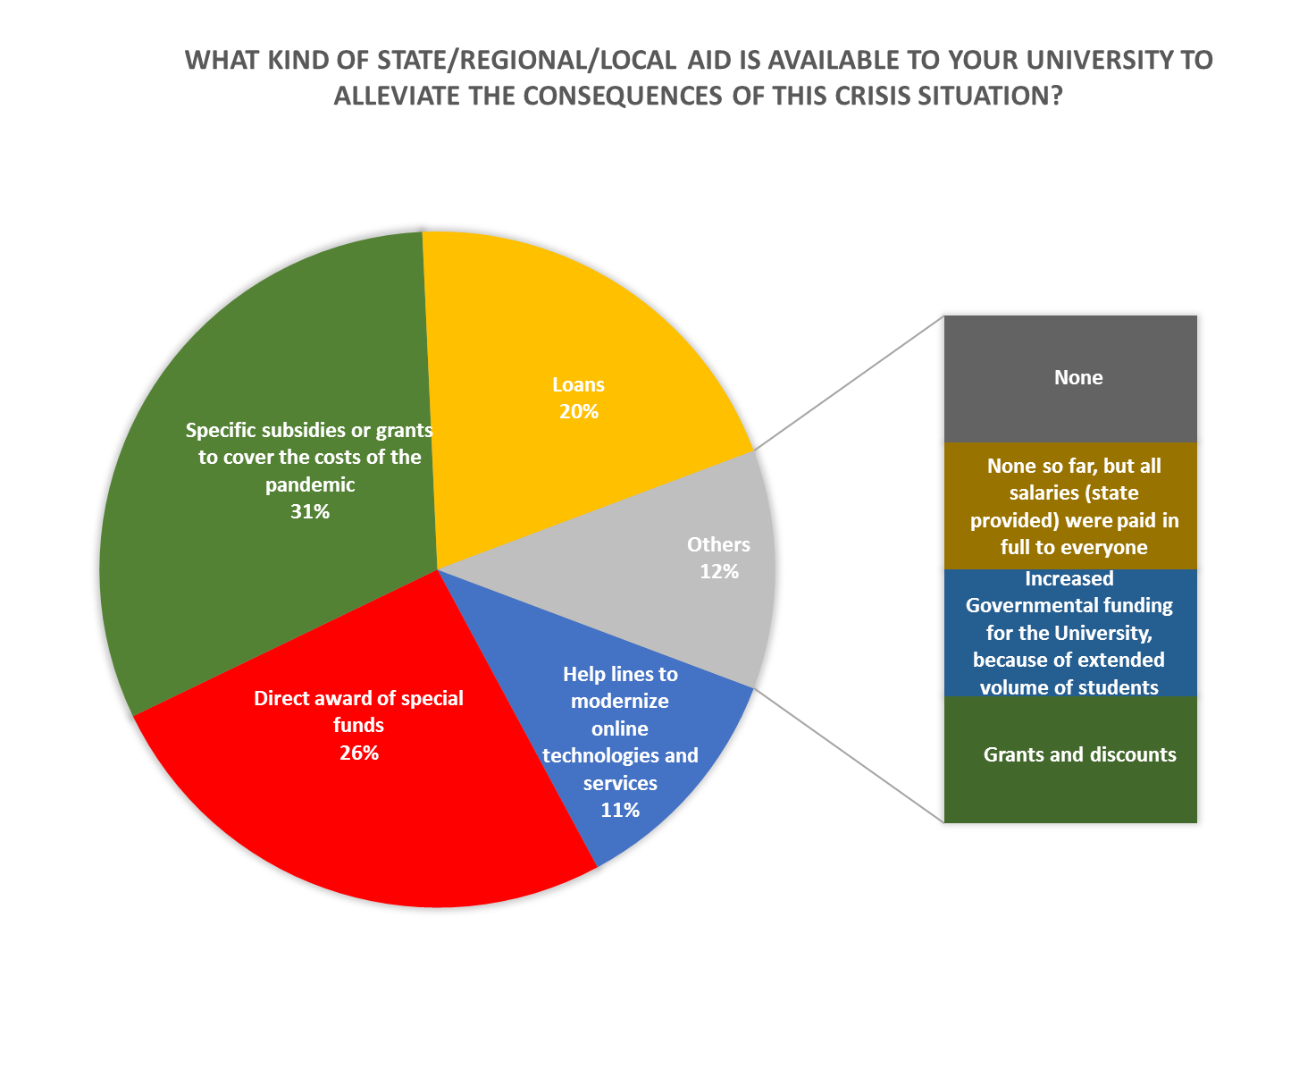
Economic aspects
Report of the CGU: ‘Impact of the Covid-19 on University Education’

Slide 11
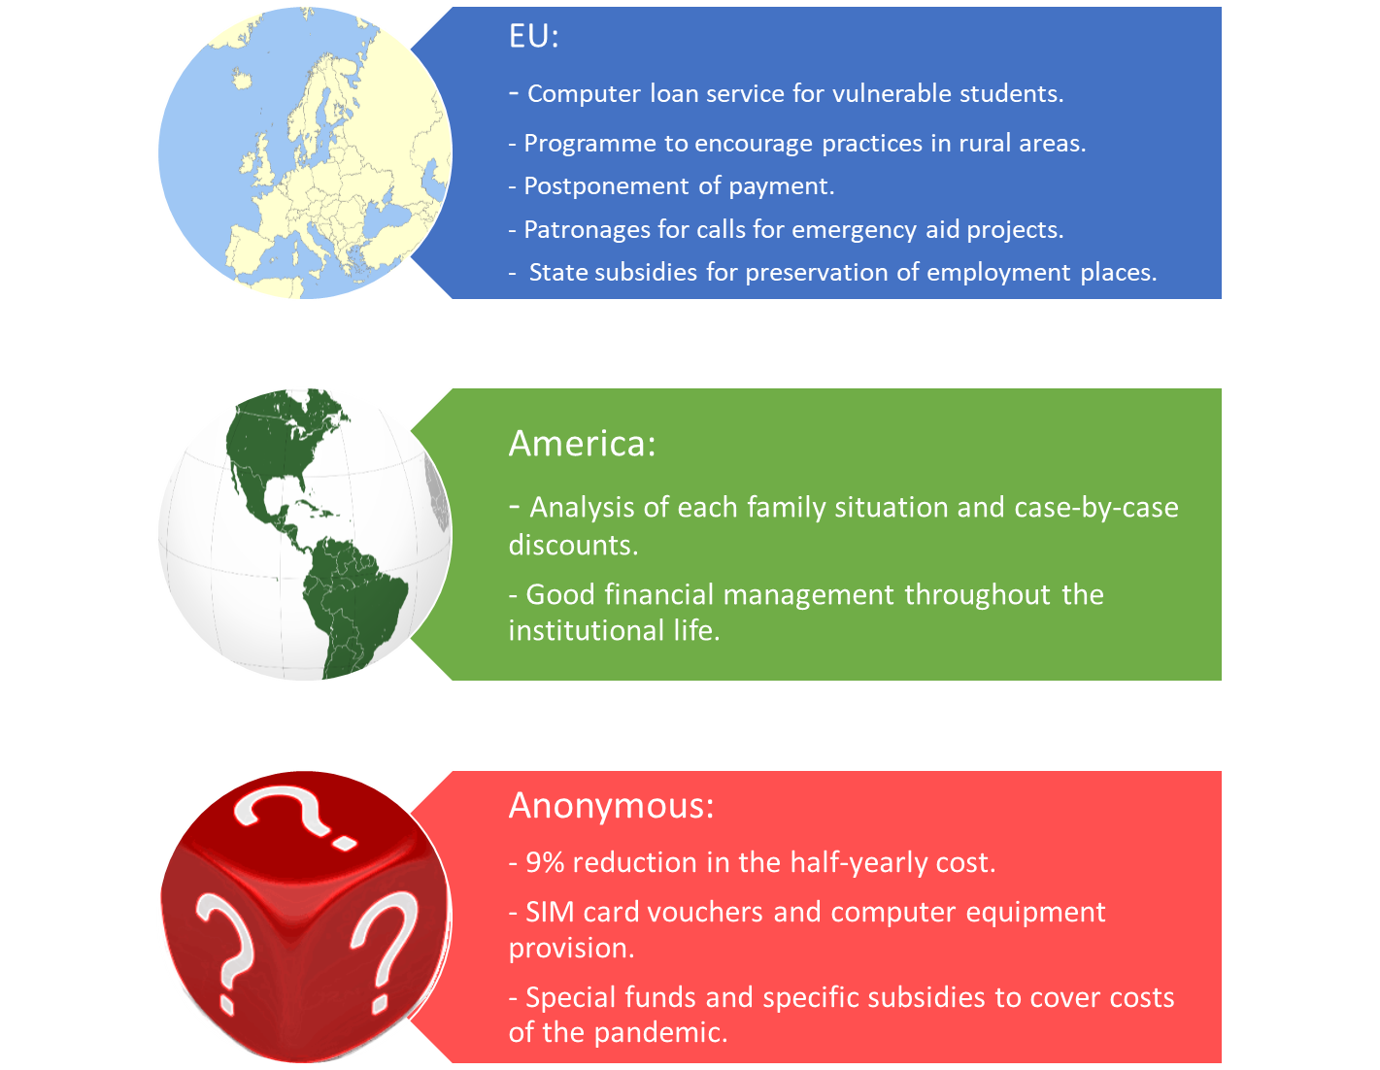
Economic aspects
ECONOMIC MEASURES STADING OUT OR MORE USEFUL THAN OTHERS
Report of the CGU: ‘Impact of the Covid-19 on University Education’

Slide 12
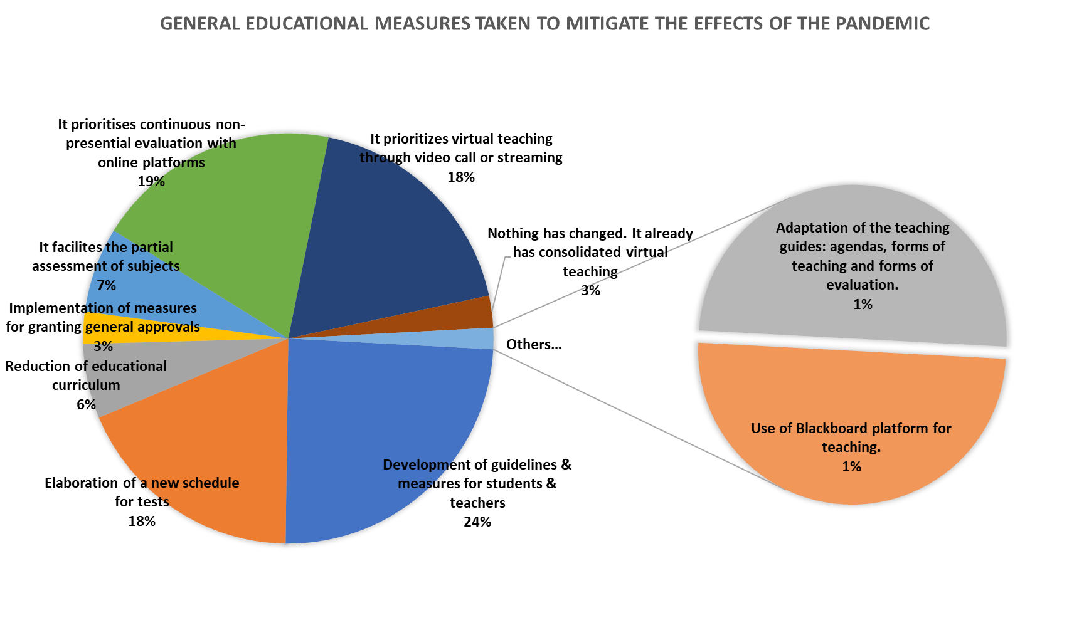
Education & research
Report of the CGU: ‘Impact of the Covid-19 on University Education’

Slide 13
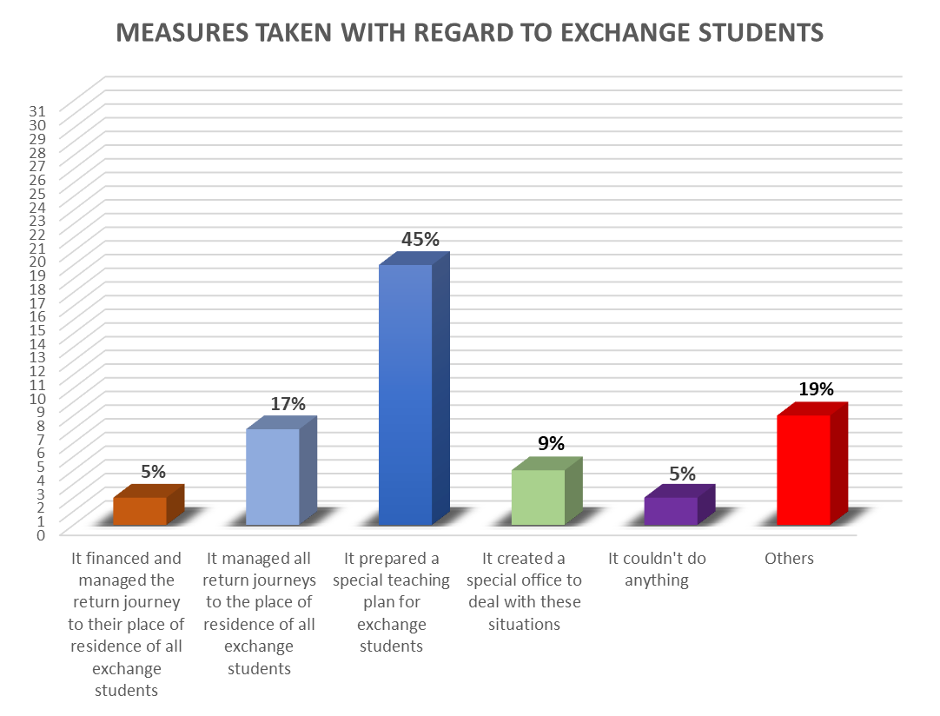
Education & research
Report of the CGU: ‘Impact of the Covid-19 on University Education’

Slide 14
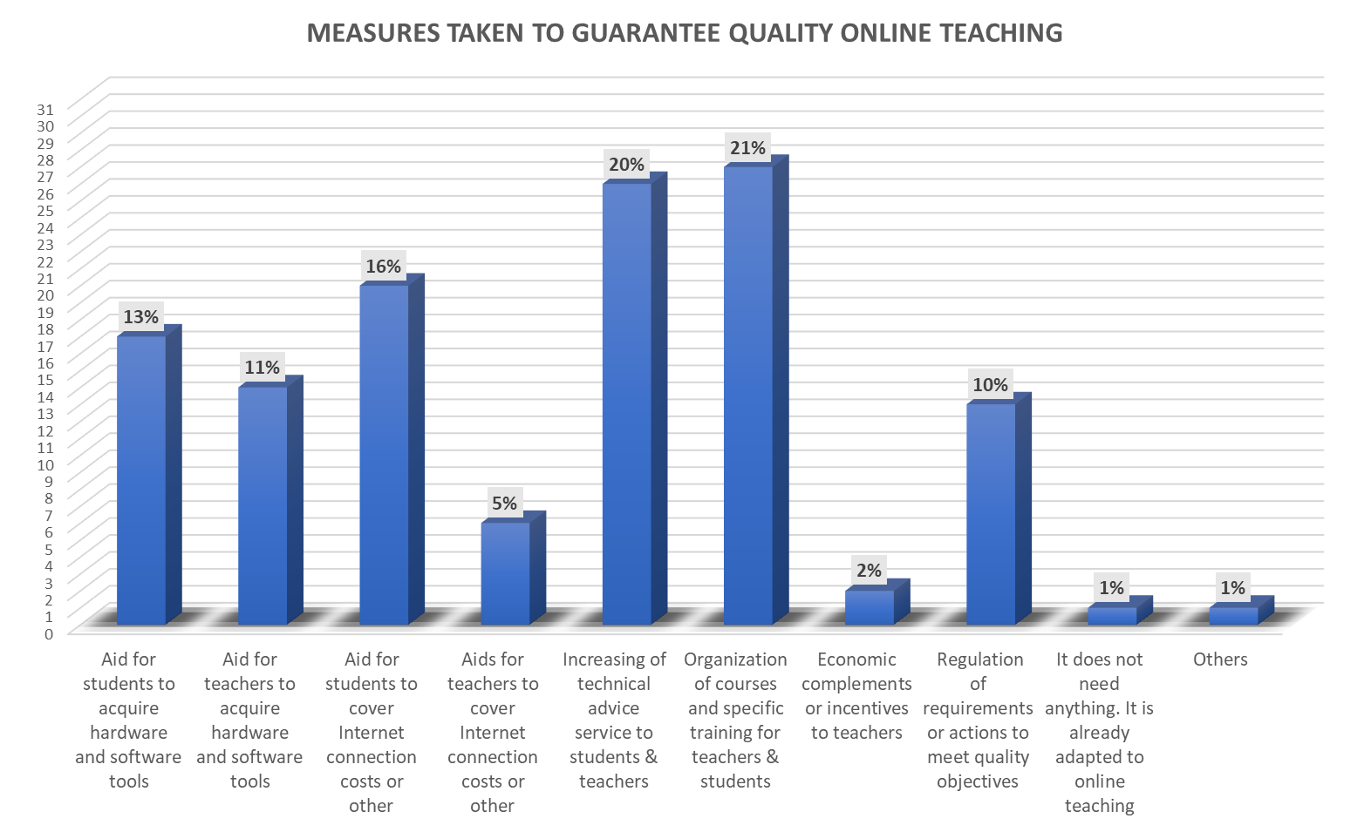
Education & research
Report of the CGU: ‘Impact of the Covid-19 on University Education’

Slide 15
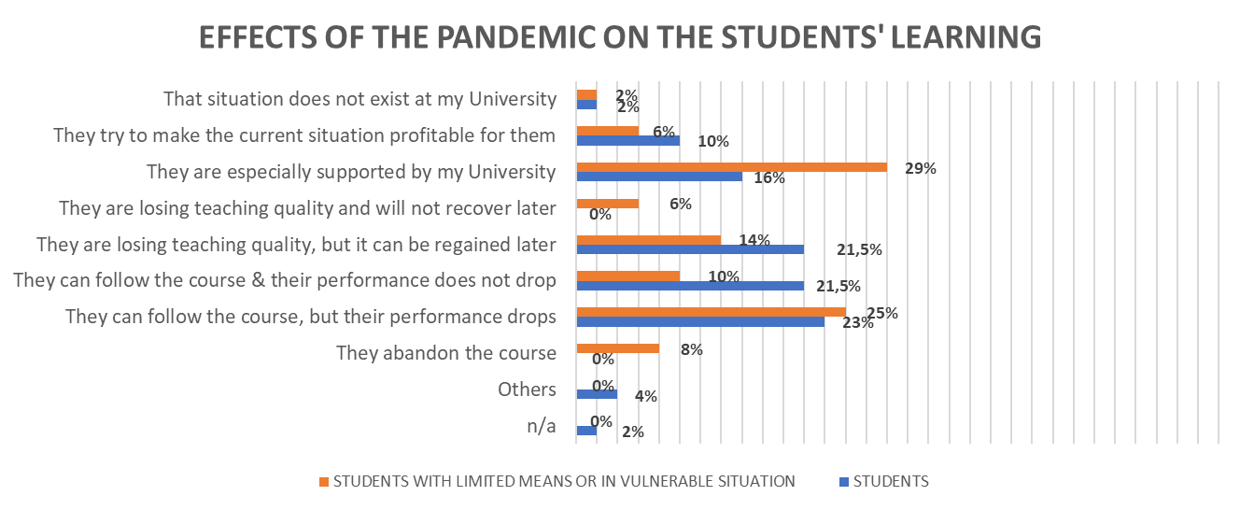
Education & research
Report of the CGU: ‘Impact of the Covid-19 on University Education’

Slide 16
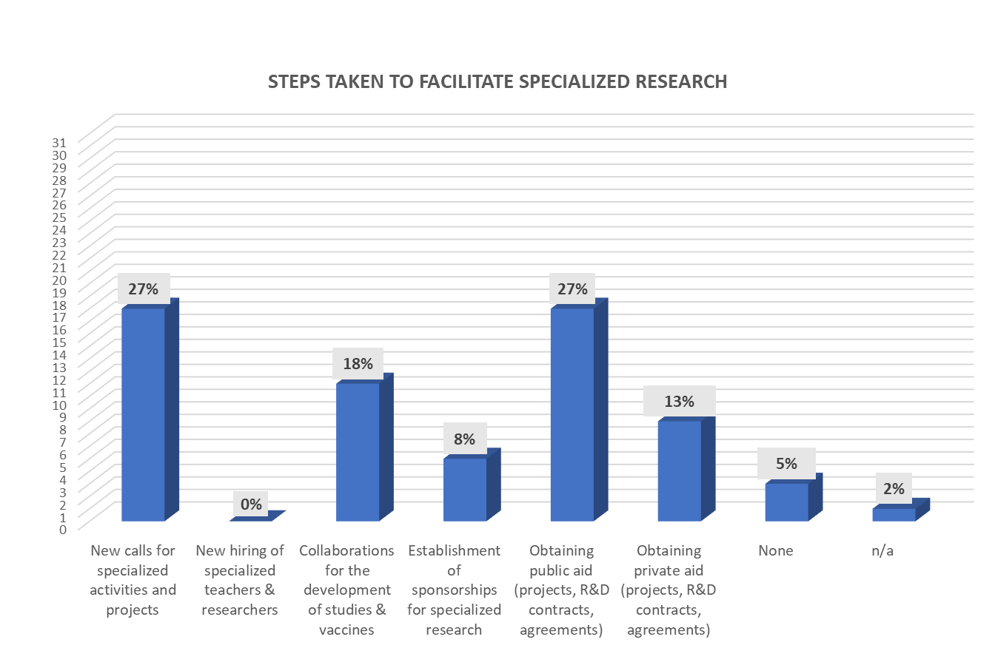
Education & research
Report of the CGU: ‘Impact of the Covid-19 on University Education’

Slide 17
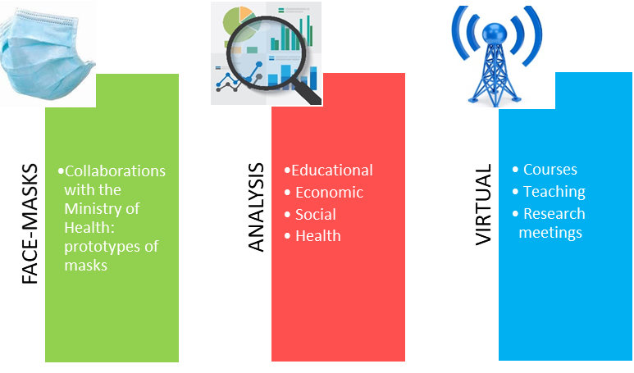
Education & research
EDUCATION & RESEARCH MEASURES STADING OUT OR MORE USEFUL THAN OTHERS
Report of the CGU: ‘Impact of the Covid-19 on University Education’

Slide 18
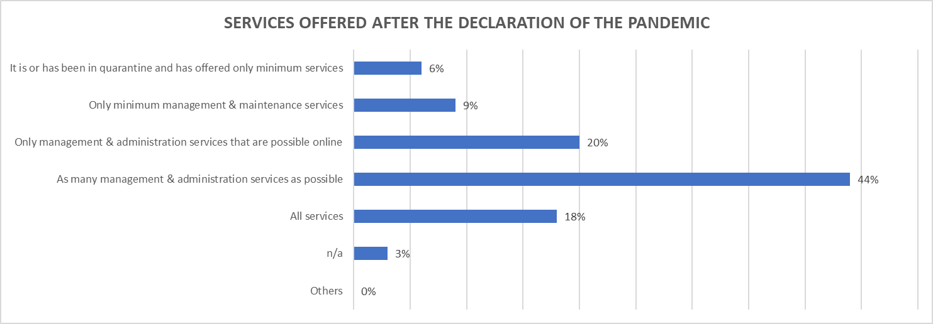
Management
Report of the CGU: ‘Impact of the Covid-19 on University Education’

Slide 19
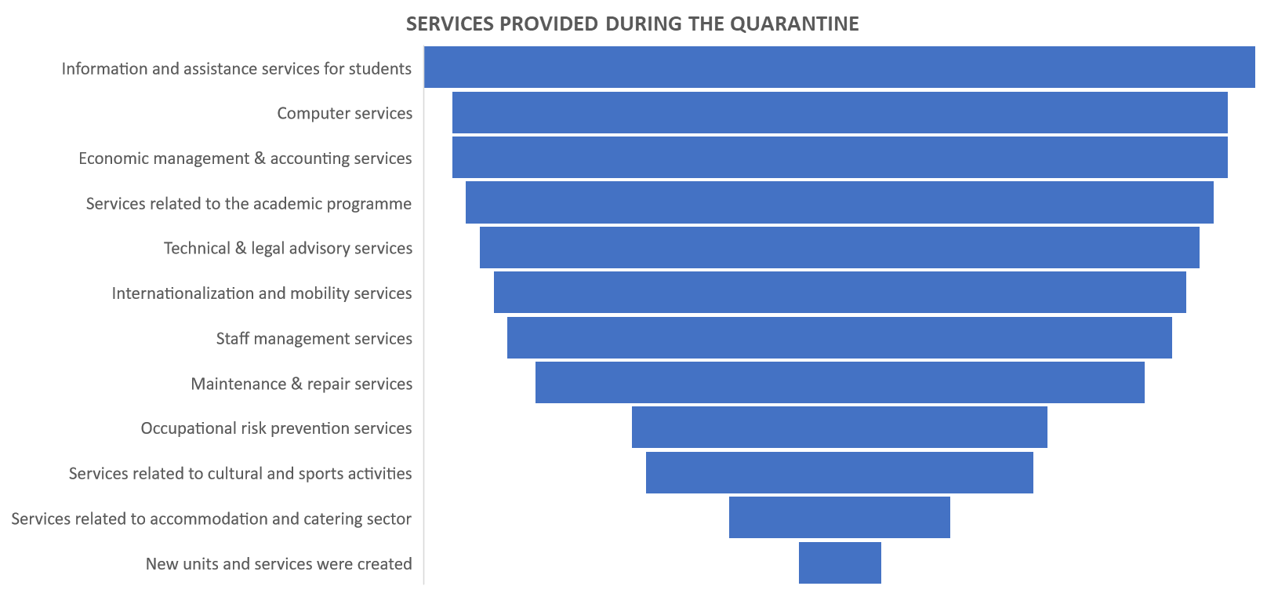
Management
Report of the CGU: ‘Impact of the Covid-19 on University Education’

Slide 20
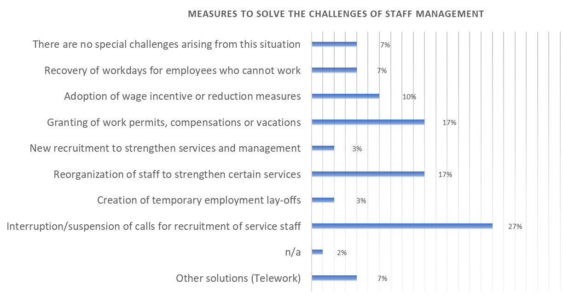
Management
Report of the CGU: ‘Impact of the Covid-19 on University Education’

Slide 21

Management
MANAGEMENT MEASURES STADING OUT OR MORE USEFUL THAN OTHERS
Report of the CGU: ‘Impact of the Covid-19 on University Education’

Slide 22
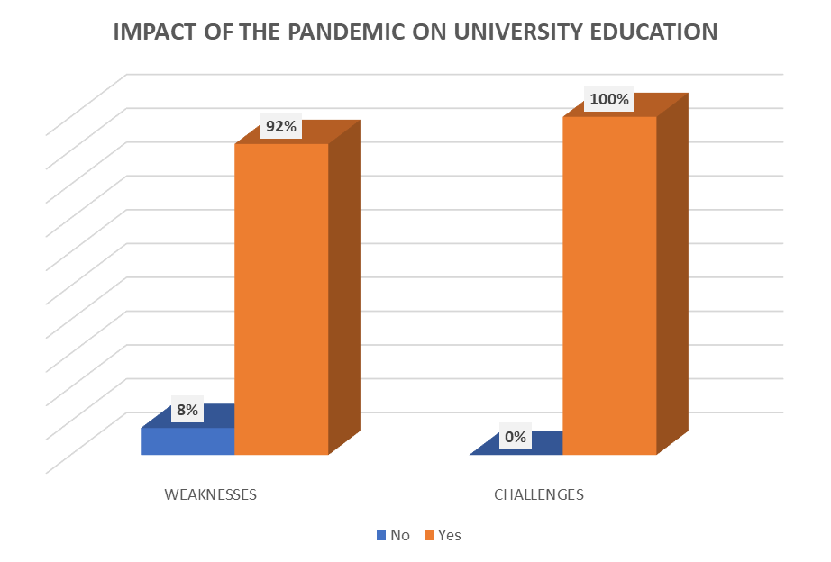
Lessons learned
Report of the CGU: ‘Impact of the Covid-19 on University Education’

Slide 23
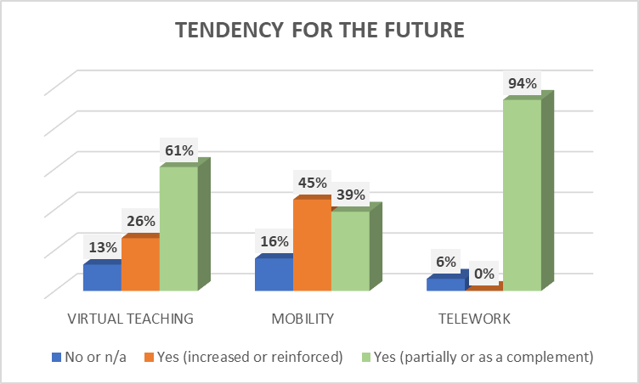
Lessons learned
Report of the CGU: ‘Impact of the Covid-19 on University Education’

Slide 24
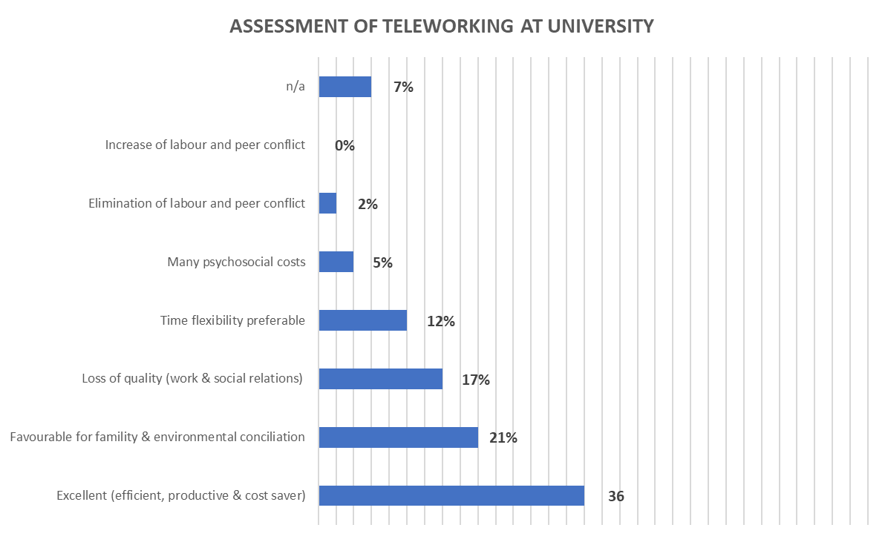
Lessons learned
Report of the CGU: ‘Impact of the Covid-19 on University Education’

Slide 25
Lessons learned
KEY ISSUES
Redesign of own processes
Strategic plan (prioritization of activities)
Financial strength
Technological strength
Leadership mentality (trusted workers)
Support teachers
Report of the CGU: ‘Impact of the Covid-19 on University Education’

Slide 26
Thank you and the respondents!
Compostela Group of Universities
www.gcompostela.org
Report of the CGU: ‘Impact of the Covid-19 on University Education’

